Slide 1

SHEKHAWATI POLYTECHNIC COLLEGE
A Project Presentation On
Tour And Travel
Submitted to:-
Mr. Suneel Kumar
HOD of CSE dept.
Submitted by:-
Ankit Kumar Jangir
P.TECH CSE 3RD YEAR

Slide 2

TOUR AND TRAVEL
“Start your journey of a thousand miles with a single step”.
www.atmakemytrip.com

Slide 3
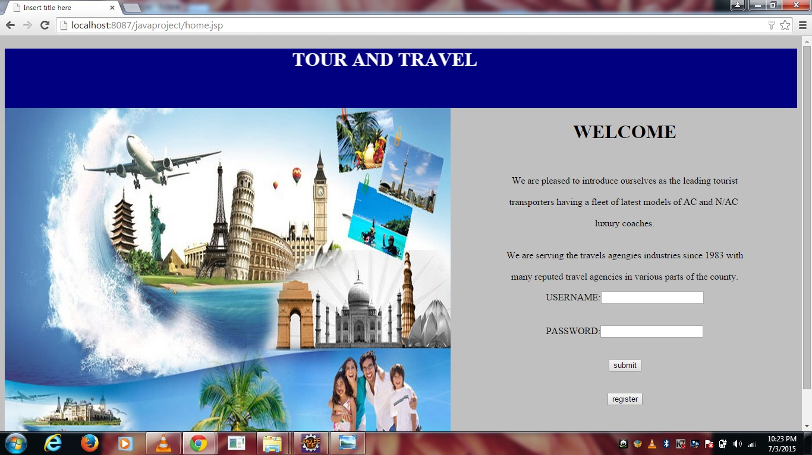
WELCOME PAGE

Slide 4
CUSTOMER

Slide 5
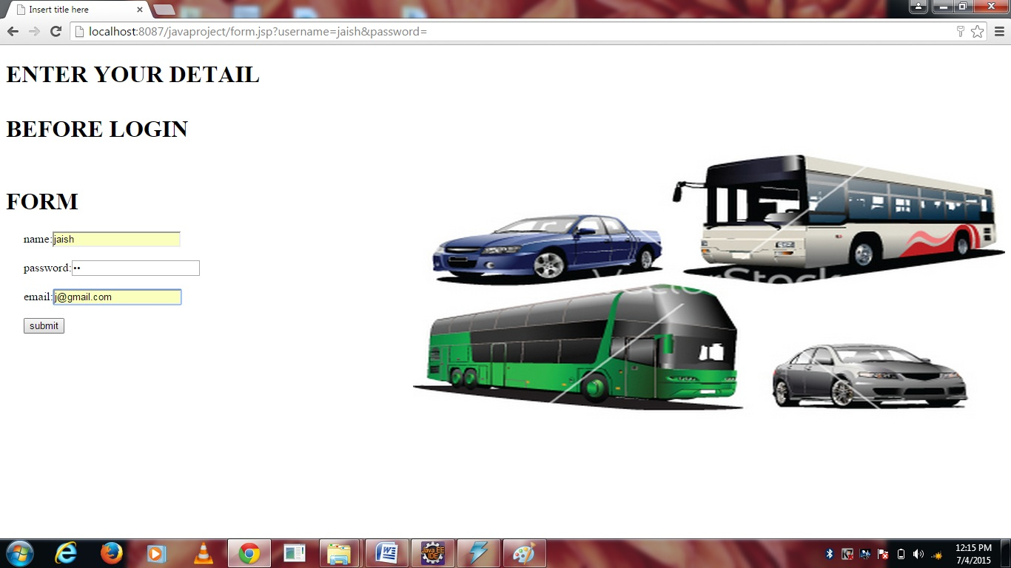
Now if you want to login as customer , first you have to register so click on “register”. Fill the form and click submit button.

Slide 6
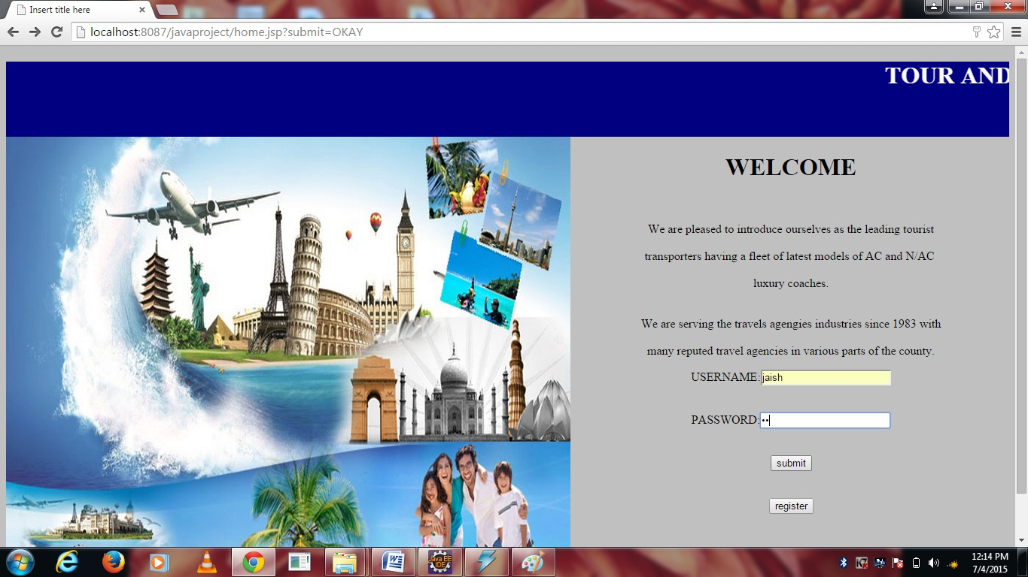
Now enter your username and password and press submit button you will successfully login as customer.

Slide 7
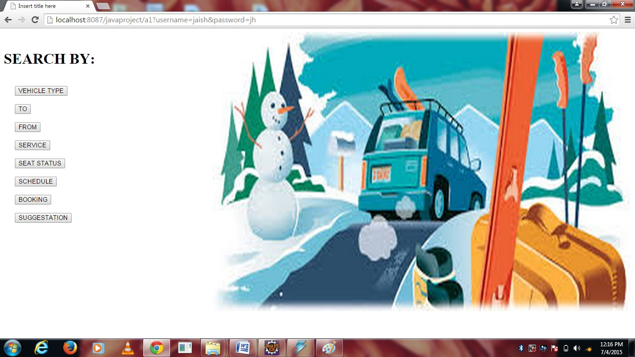
There are options available to search . Choose as per your need .

Slide 8
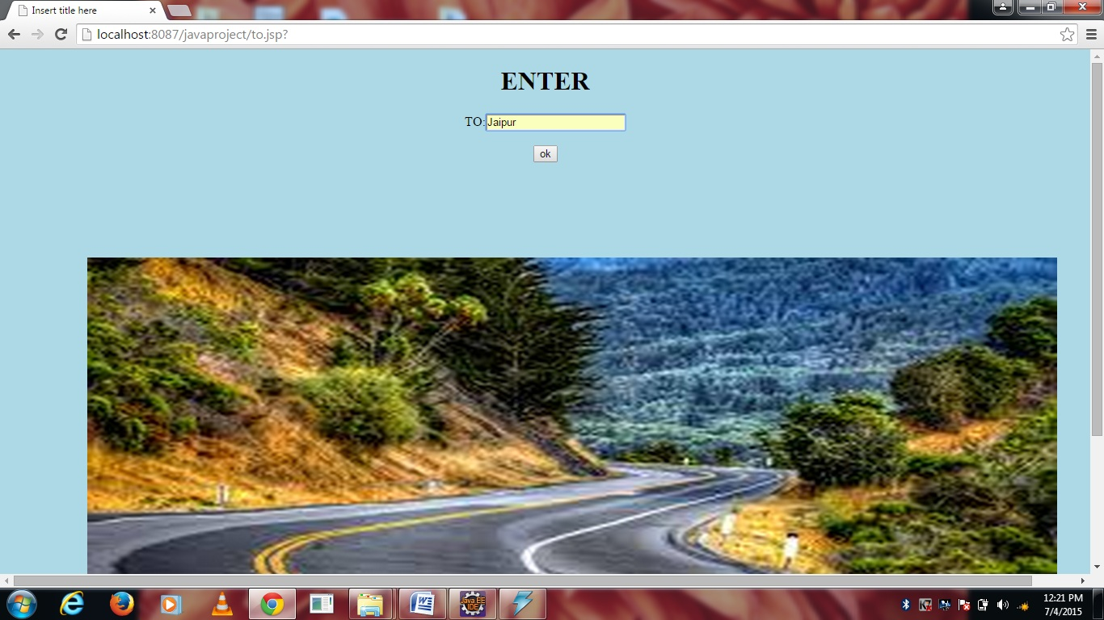
Suppose you press “to". Then enter the detail (for e.g. jaipur) and press “ok”.

Slide 9
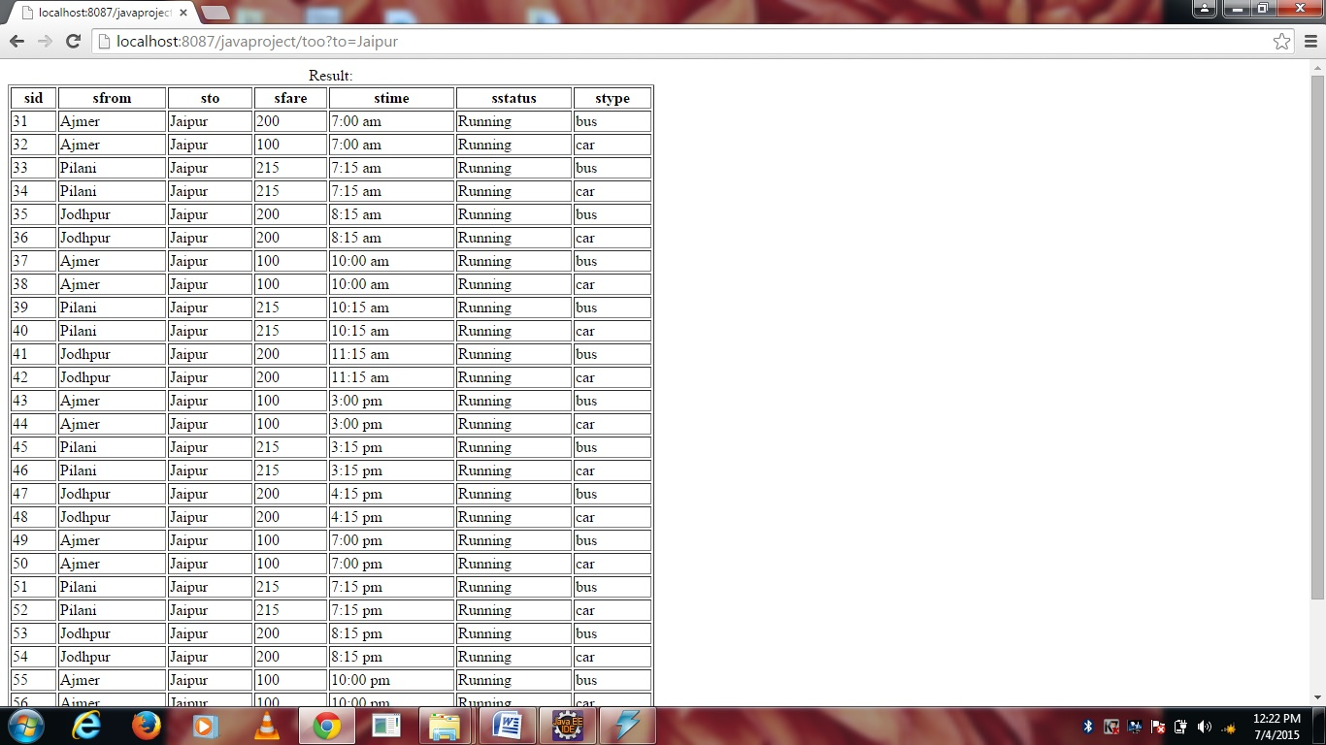
Then you will get the result as shown below(schedule of buses and cars to Jaipur)

Slide 10
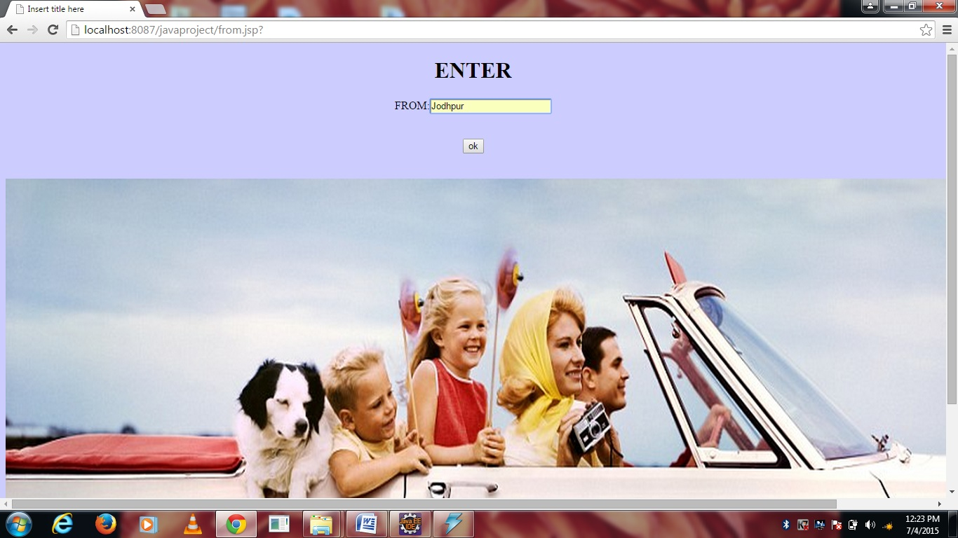
If you press “from” then enter the detail (for e.g. jodhpur),then click “ok”.

Slide 11
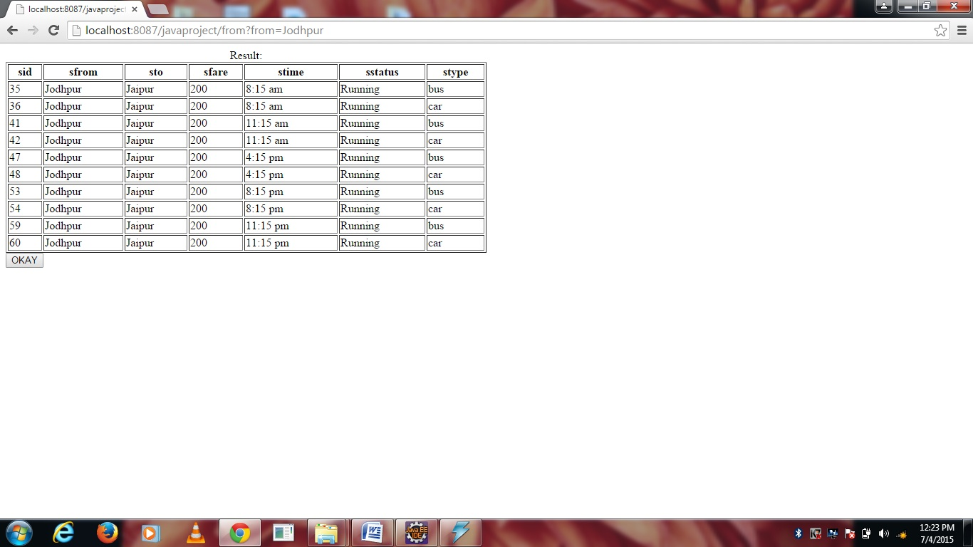
Then you will get the result(schedule of buses and cars from jodhpur)

Slide 12
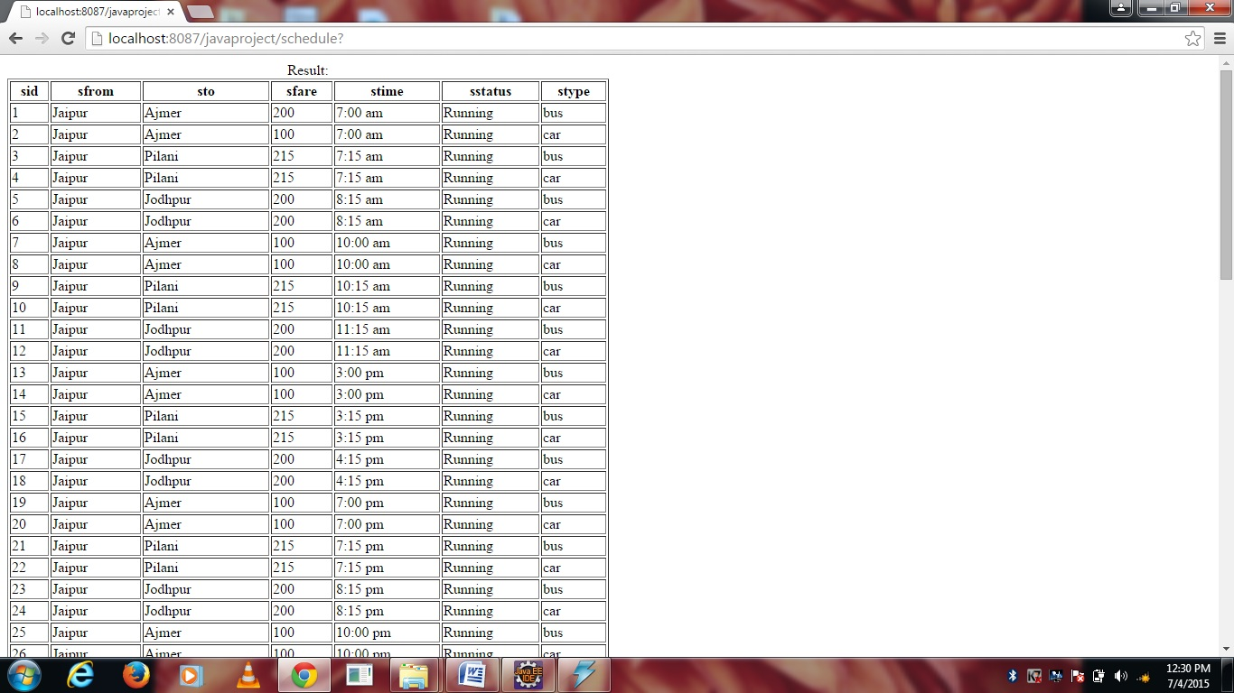
Now if you want to see the whole schedule press “schedule”.

Slide 13
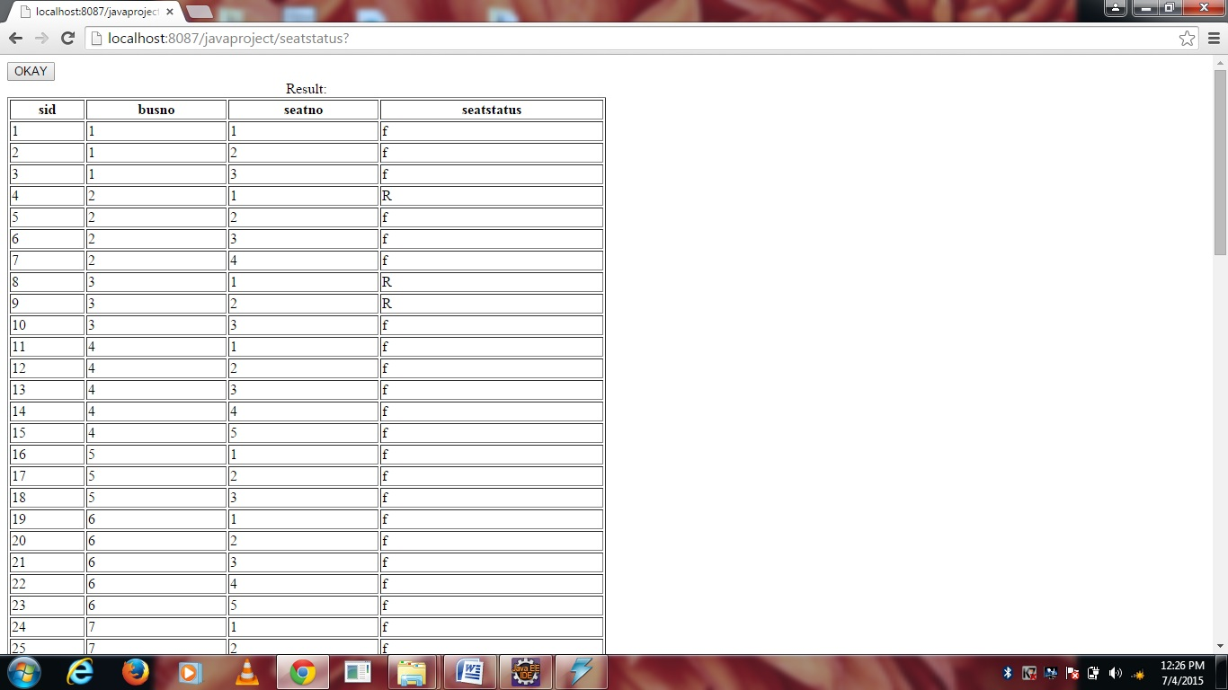
If you want to see the seat status then press “seat status”.

Slide 14
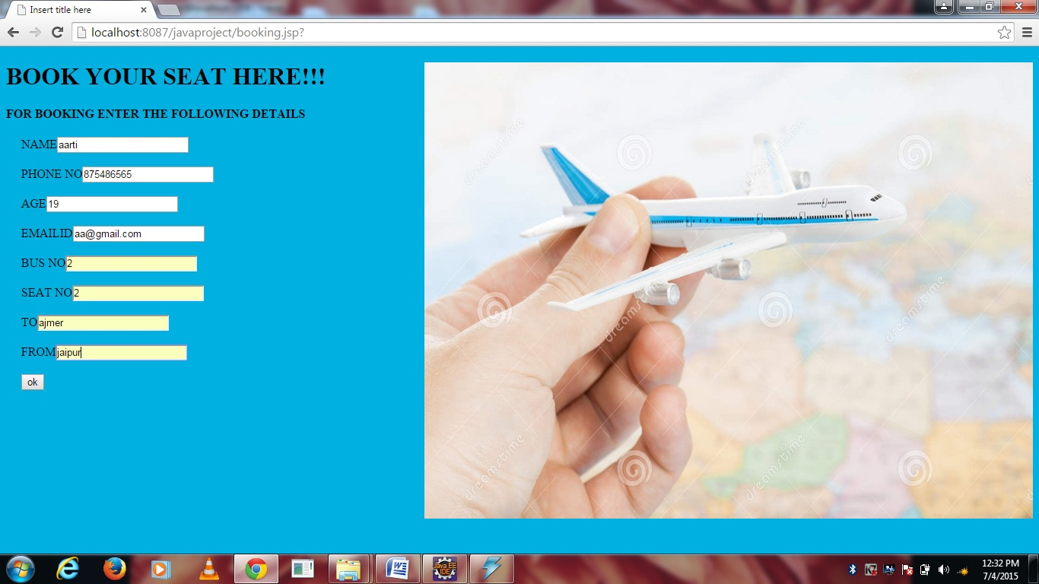
Now if you want to book any seat then press “booking”. Fill the details and press “ok”.

Slide 15
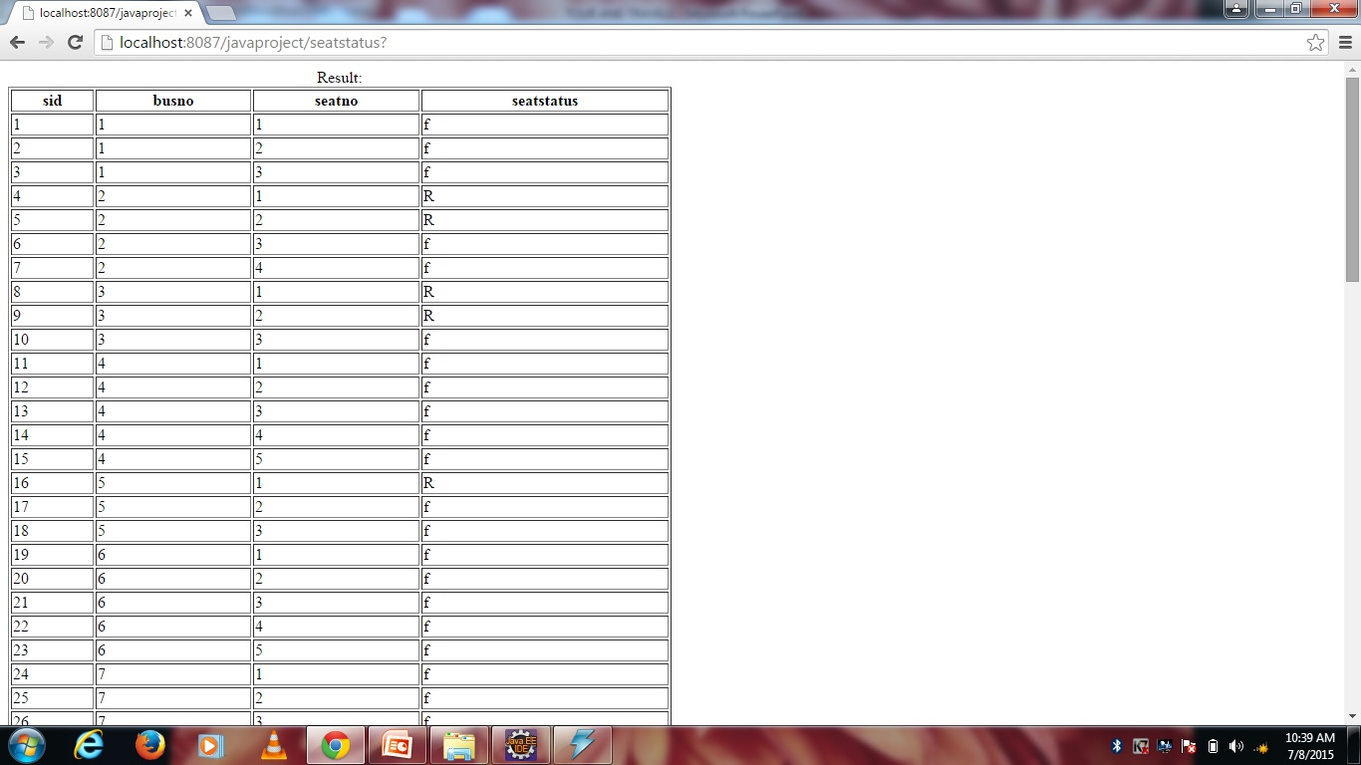
As now you have booked seat no 2 of bus no 2 so the seat status will be reserved.

Slide 16
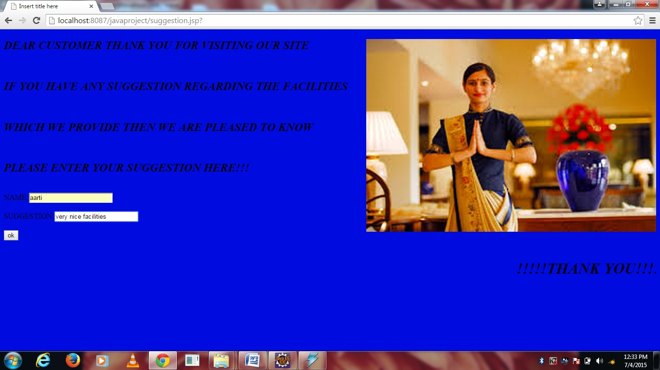
If you want to put any suggestion press “suggestion”. Fill the details and press “ok”.

Slide 17
ADMIN

Slide 18
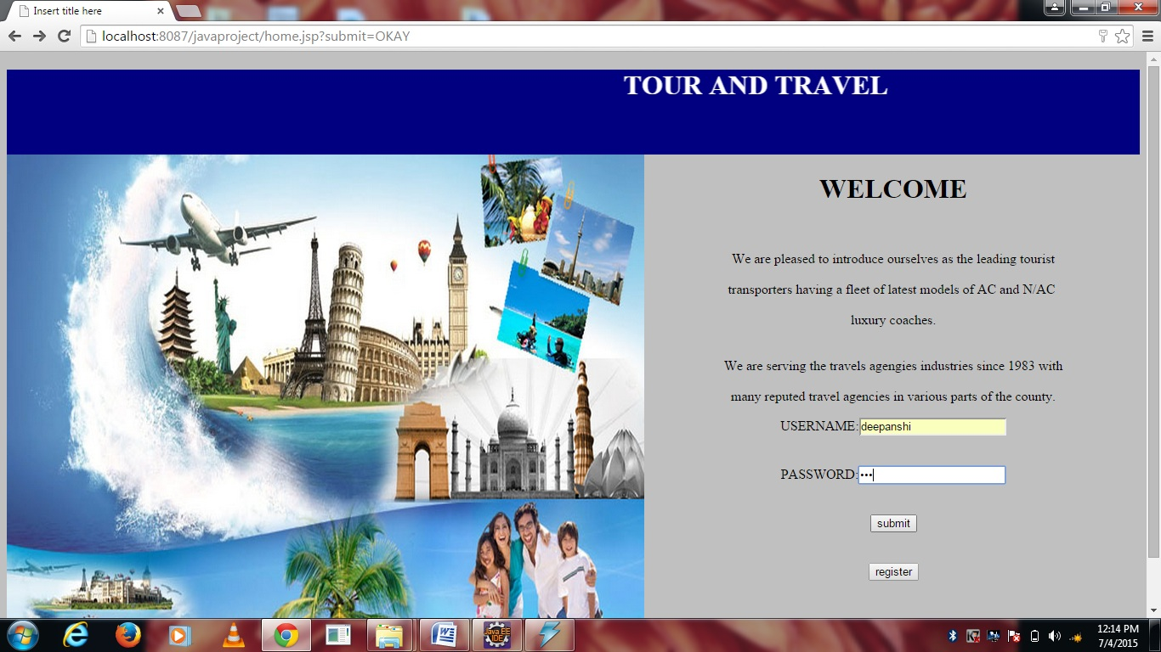
If you are admin enter the user name and password at the home page and press “submit”.

Slide 19
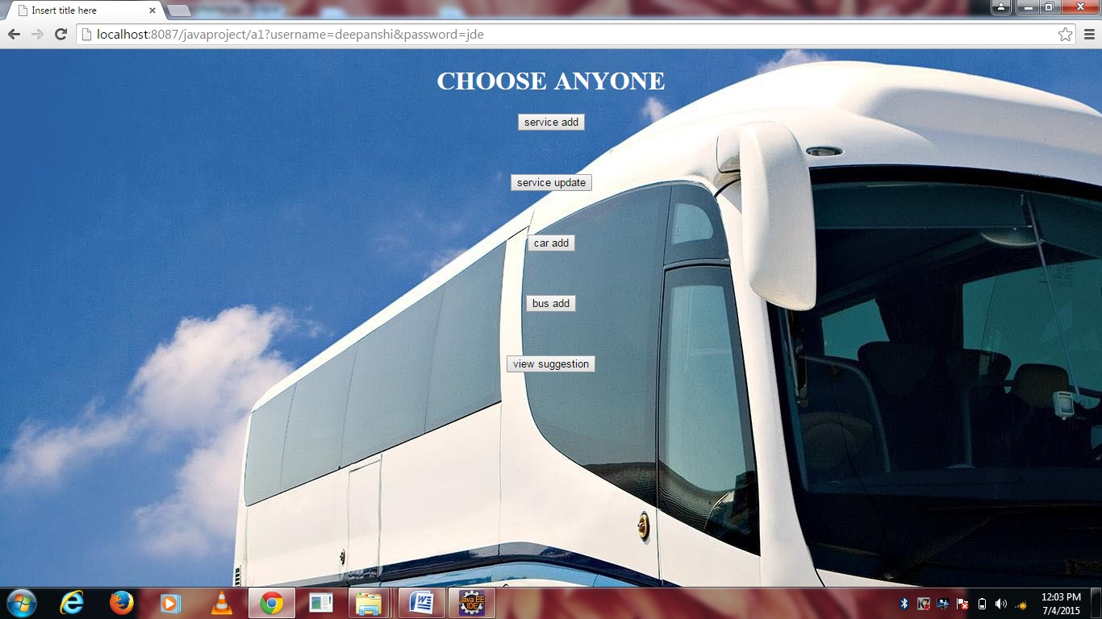
There are available like service add ,service update options etc. choose as per your need.

Slide 20
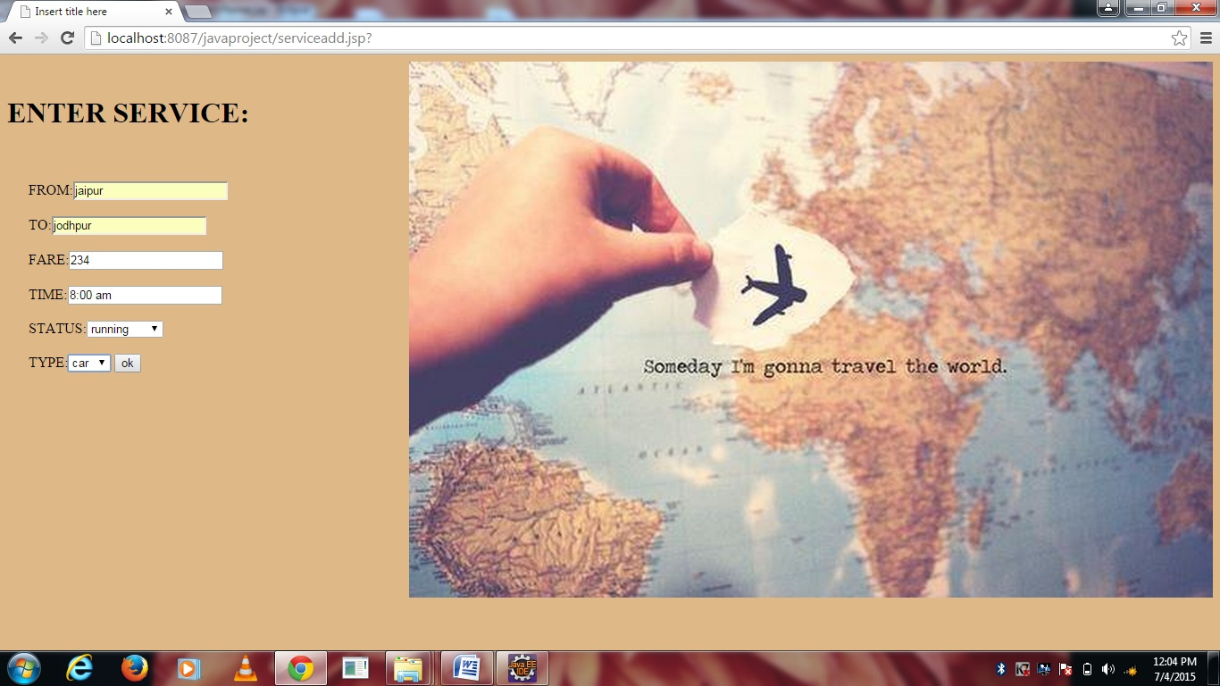
Now if you(admin) want to add any new service then press “service add”. Fill the details of new service and press “ok”.

Slide 21
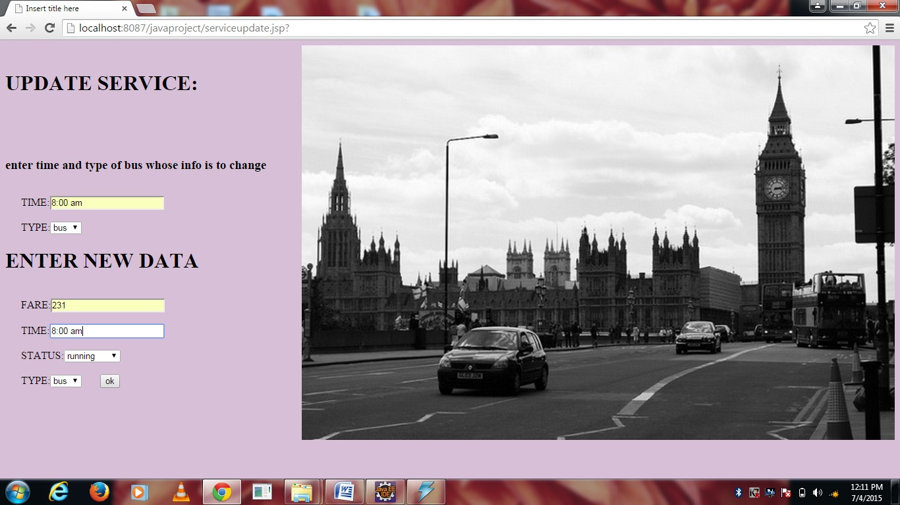
Now if you (admin) update any service then press “service update”.

Slide 22
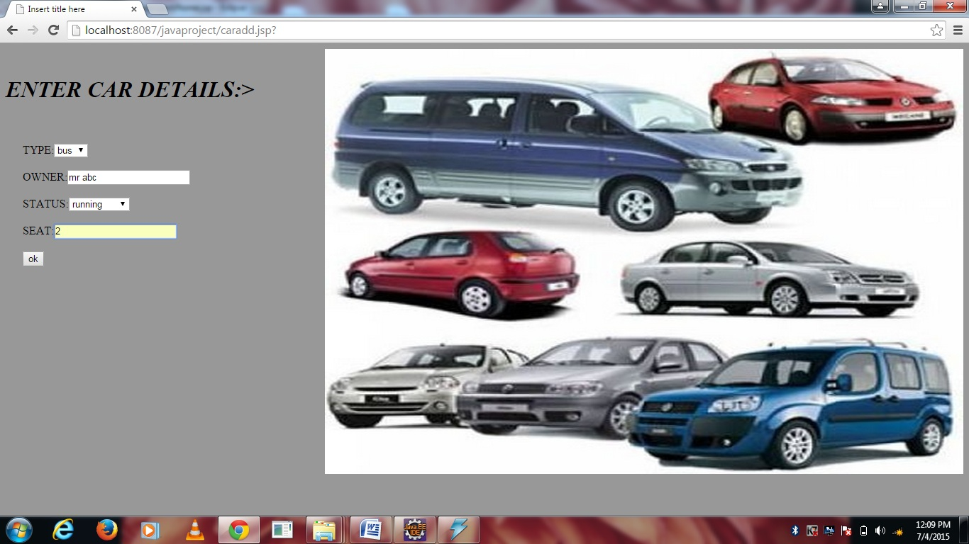
If you(admin) to add any new vehicle (car) press “car add”. Fill the details and press “ok”.

Slide 23
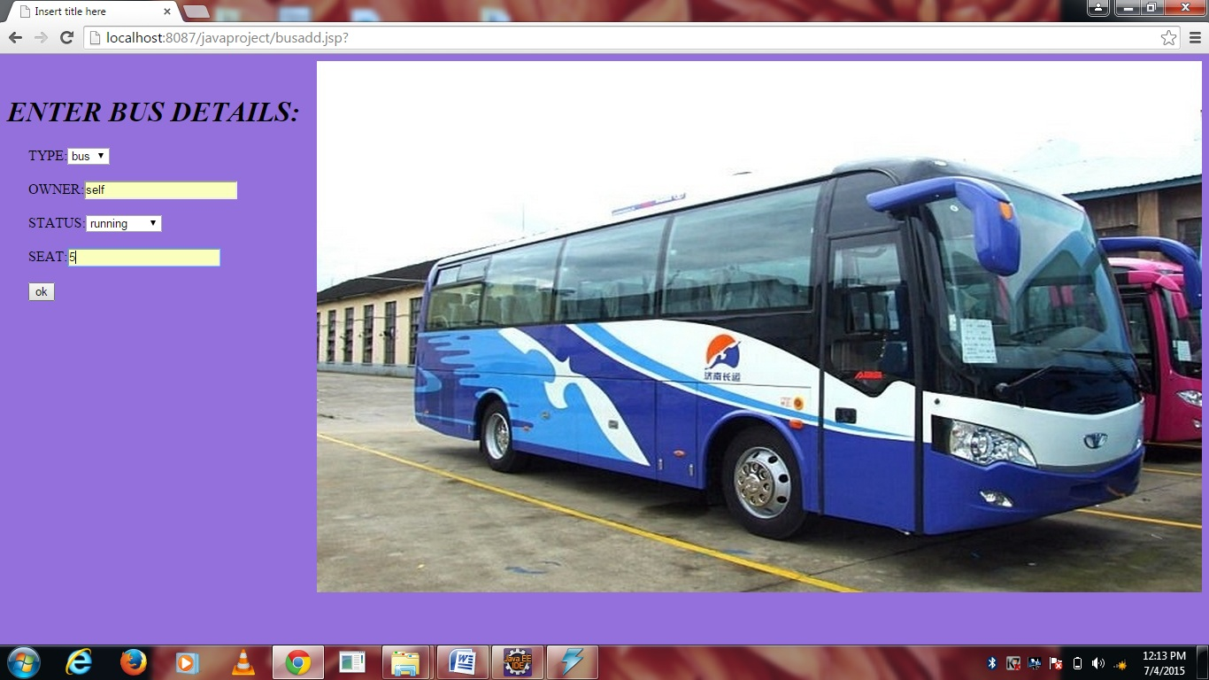
If you (admin) want to add any new vehicle (bus),then press “bus add”. Fill the details and press “ok”.

Slide 24
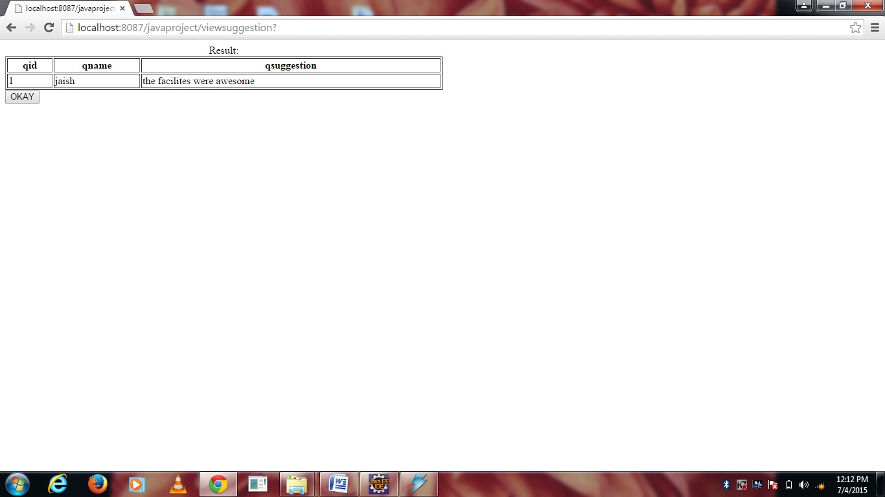
If you (admin) want to see suggestion given by customers then press “view suggestion”.

Slide 25
. .
THANK YOU

